Slide 1

MICROSOFT FILM INDUSTRY
MICROSOFT FIRST FILM/MOVIE INDUSTRY

Slide 2

Summary
Let’ Dive In
From the analysis done, we expect to have results of the following:
The highest profit made throughout the years.
The company's’ focal point.
The movies that bring the highest income.
The top studios and the income generated.
The top genres and income generated
Skewerness and kurtosis of the run time.

Slide 3

Agenda
INTRODUCTION
SUMMARY
OUTLINE
BUSINESS PROBLEM
DATA
TECHNIQUES
RESULTS AND FINDIGS
RECOMMENDATION
REMARKS

Slide 4

BUSINESS PROBLEM
Microsoft has been widely known for their lead developer of the personal computer software and applications. From when it was just a mainframe computer programming language used for the early pcs to now becoming the lead experts in top production of software.
The starting of the film industry is one of the recent transition he company has implemented. As a beginning film industry , there is a need for data analyst to help in movie/film recommendation

Slide 5
DATA
The data used in this analysis is from the following sites:
Box Office Mojo.
The Numbers
IMDB

Slide 6

TECHNIQUES
There are techniques incorporated when performing data preparation:
The missing values were handled by dropping off some of the columns or filling with mean/median of the data depending on the scenario.
The duplicated values were dropped.
The cleaned data was the one used in analysis.
Data visualization was used to answer the problem statement with the visuals.

Slide 7

RESULTS

Slide 8
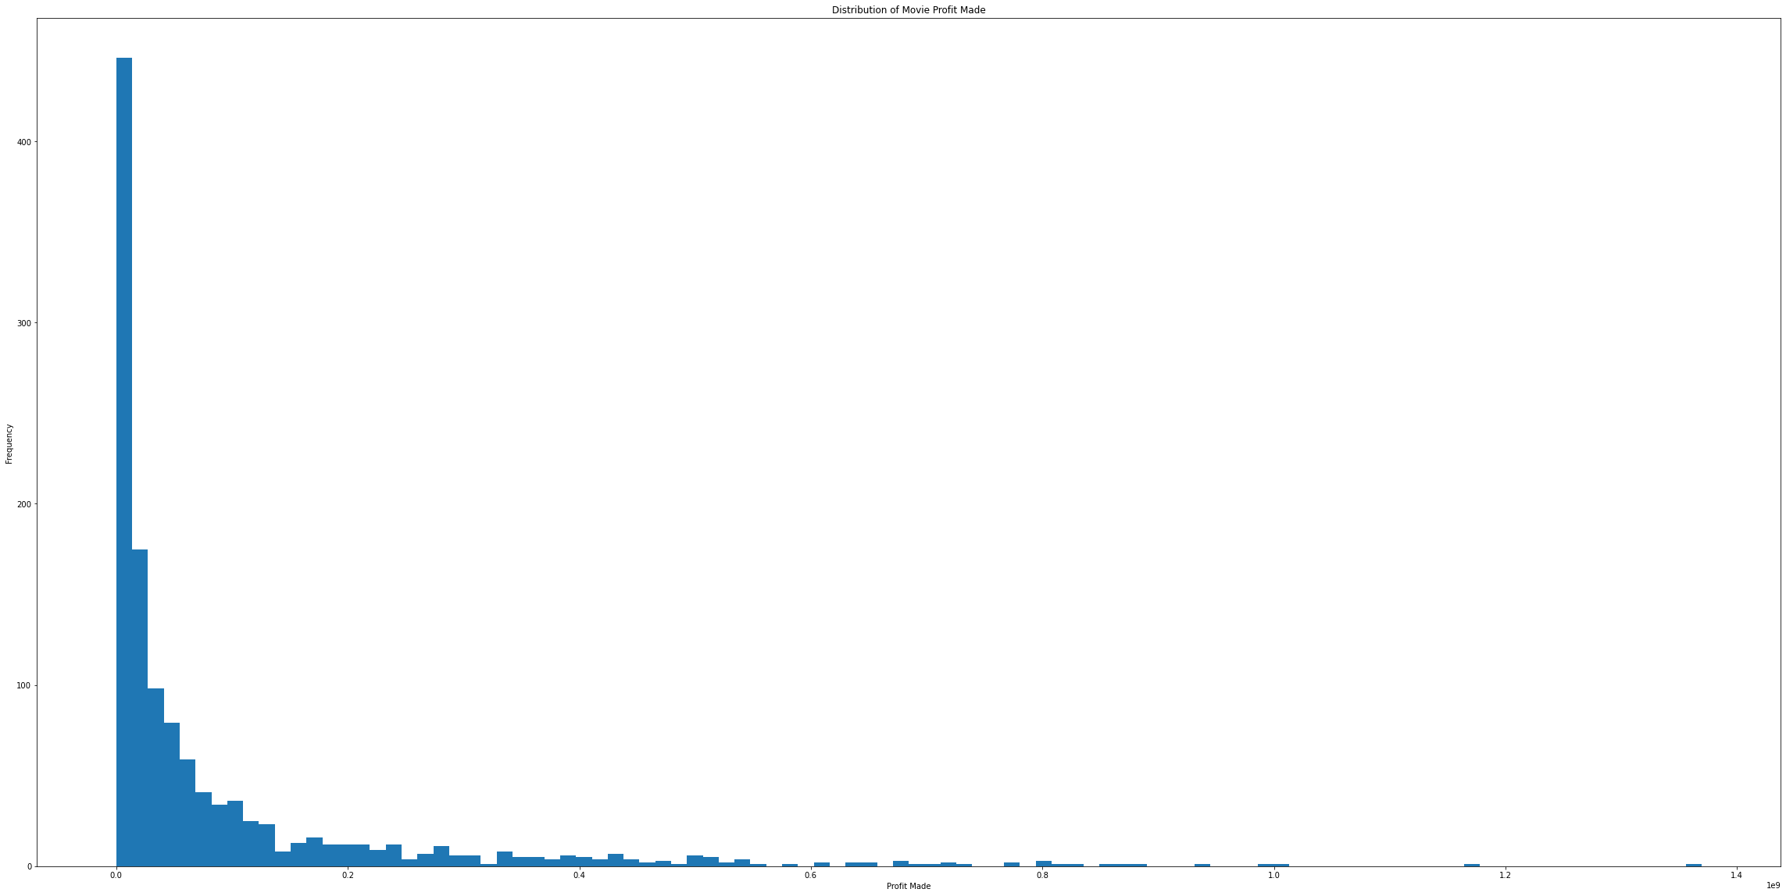
Highest profit
The movie that has the highest profit is Avengers Infinity war.
Profit made was 1369318718.0

Slide 9
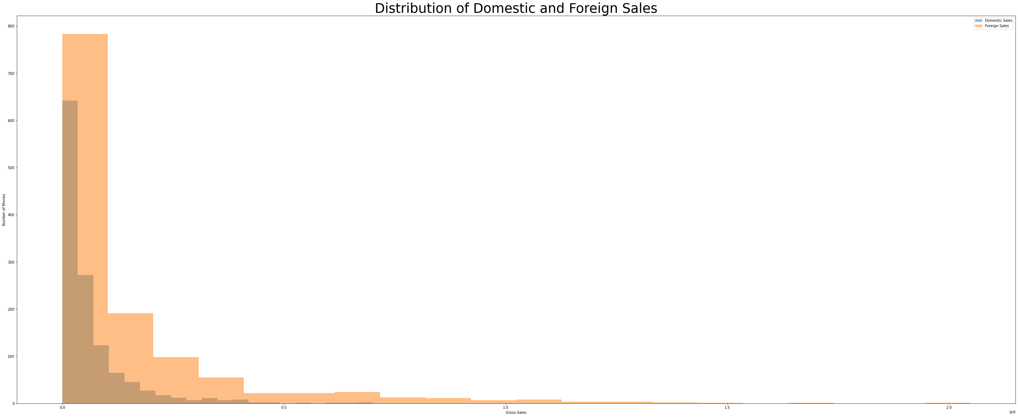
Company's’ FOCAL Point
Based on that the company should focus on:
This focused on the sales between domestic and foreign gross.
This were the sales made:
The average domestic sales: 60623530.9124498
The average foreign sales: 152125895.94947875
The Difference: -91502365.03702894

Slide 10
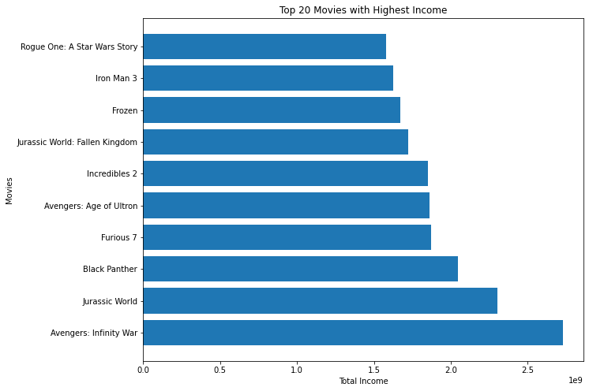
Finding the top 10 movies

Slide 11
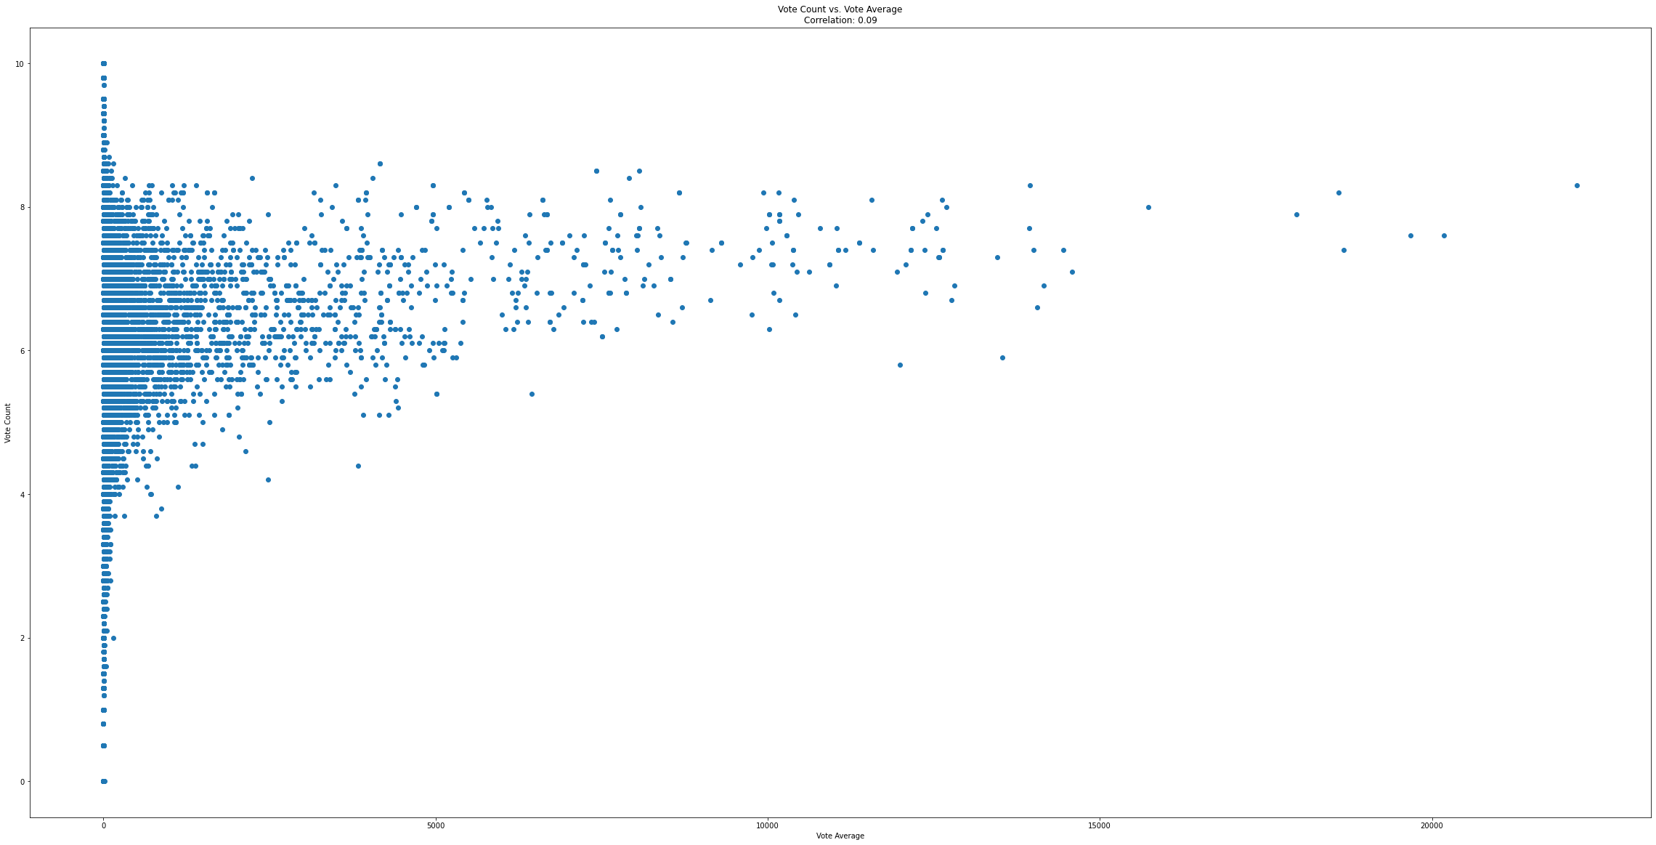
Correlation between ‘vote_count & vote average
Correlation between vote_count and vote_average: 0.08636988831138752

Slide 12
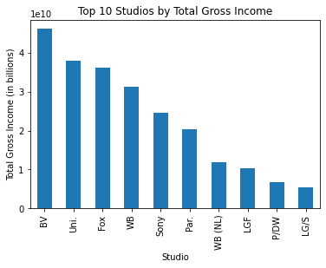
Top 10 studios by total gross income
These are the top 10 recommended sudios:
BV
Uni.
Fox
WB
Sony
Par
LGF
P/DW
LG/S

Slide 13
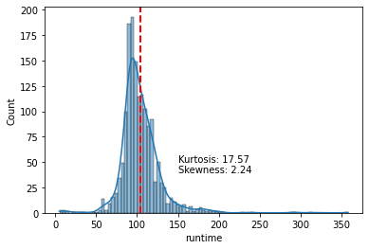
Skewness and Kurtosis of the 'runtime
Runtime skewness: 2.242613327185838
Runtime kurtosis: 17.572857716979282

Slide 14

RECOMMENDATION
Top Genre:
Drama/Mystery and suspense- this genre has a high total gross
Top Studios to consider:
BV
Uni.
Fox
WB
Sony
Par
LGF
P/DW
LG/S

Slide 15

WHAT NEXT
Web Scrapping -This is done to obtain the current data from the movie sites so as to carry out analysis with the precedent/current events.
Having specificities in terms of giving the specific movie category.
Coming up with the right predictive model to analyze the movies, improve accuracy and even offer a better suggestion to take.

Slide 16

THANK YOU
wanjikuedna3@gmail.com
LinkedIn:
https://www.linkedin.com/in/edna-wanjiku-70647419b/

